Slide 1
CORPCAN Intelligent ITEnablers Project
Presenter: Jackie Cheng Date: December 2024
Modernizing Legacy Corporations Canada Applications with AWS AI/ML services using Amazon Comprehend and Sagemaker

Slide 2
Background & Context
Legacy applications at Corporations Canada have limited insights and manual content processing.
Objective: Transform these legacy systems into intelligent, data-driven platforms.
Approach: Leverage AWS AI/ML for improved content analysis, data governance, and analytics.

Slide 3
Project Objectives
Intelligent Content Analysis: Move beyond simple keyword searches to context-aware understanding.
Advanced Data Governance: Implement field-level visibility and robust security controls.
Scalable Data Analytics: Provide on-demand insights, reduce manual processing, and enhance decision-making.

Slide 4
Technical Architecture Overview
Data Lake: AWS Data Lake on S3 for centralized, raw data storage.
ETL & Ingestion: AWS Glue for automated pipelines.
Data Governance: AWS LakeFormation for fine-grained access control.
Analytics: Athena and Redshift for querying and analysis.
Content Analysis: Amazon Comprehend for NLP/NLU tasks

Slide 5
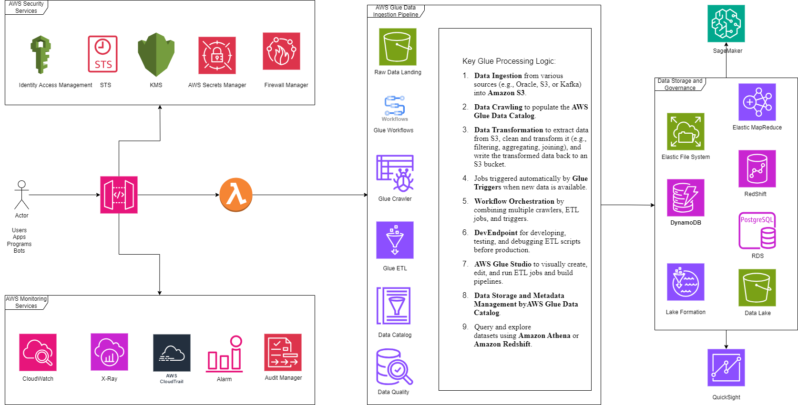

Slide 6
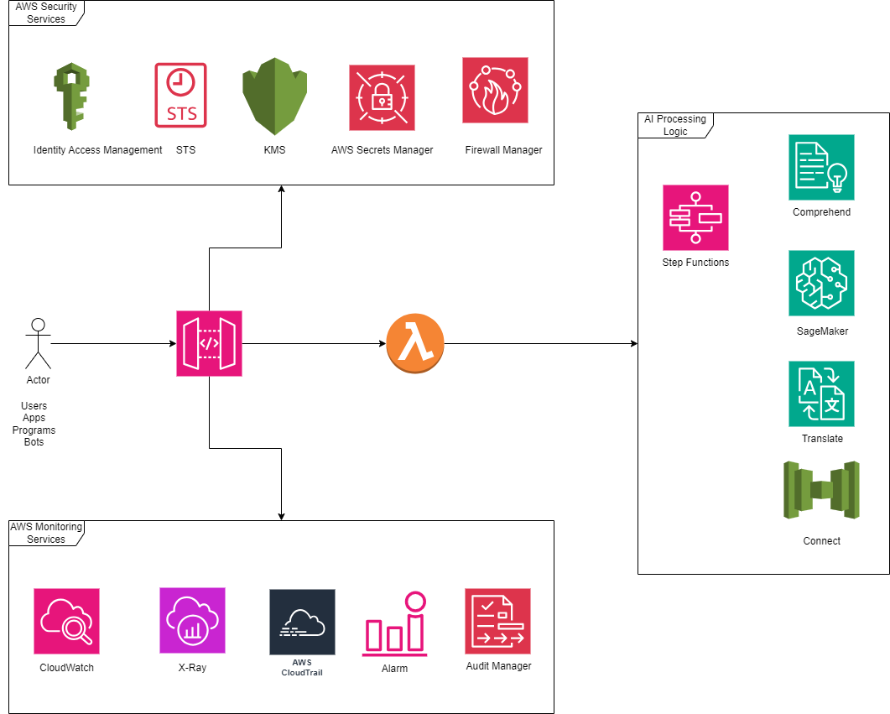

Slide 7
Intelligent Content Analysis
Use Amazon Comprehend to extract entities, detect sentiment, and identify key phrases in corporate documents.
AWS Lambda with Python ML libraries (Numpy, SpaCy, Pandas, NLTK) to classify and contextualize text data.
Improves response relevance and speeds information retrieval.

Slide 8
Data Governance & Security
Field-Level Access Control: AWS LakeFormation to govern sensitive data fields.
Robust Authentication & Authorization: AWS IAM, Amazon Cognito, Managed Active Directory (MAD).
MFA & Federation: SAML and OAuth2 for secure user authentication and authorization.

Slide 9
Analytics & Reporting
Ad-hoc Queries: Amazon Athena for serverless SQL queries over Data Lake.
Data Warehousing: Redshift for complex analytical workloads.
Visualization: AWS QuickSight for interactive dashboards and sentiment accuracy reports.

Slide 10
Enabling Technologies
AWS Glue, LakeFormation for data pipelines and governance.
Amazon Comprehend for NLP-driven content insights.
AWS QuickSight for reporting and KPIs.
AWS IAM, Cognito, MAD for security and identity management.
Lambda, DynamoDB, RDS for serverless computations and storage.

Slide 11
Outcomes & Benefits
Improved Decision-Making: Near real-time insights and KPI dashboards.
Enhanced User Experience: Context-aware, faster responses to inquiries.
Stronger Security & Compliance: Fine-grained access, MFA, and data governance.
Scalability & Future-Readiness: Serverless, AWS-native, easily extensible architecture.

Slide 12
Future Enhancements
Refine NLP Models: Continuous improvement of content understanding.
Predictive Analytics: Integrate AWS SageMaker for forecasting and advanced ML use cases.
Evolving Compliance: Ongoing audits and updates to security and governance as regulations change.

Slide 13
Conclusion
The CORPCAN Intelligent ITEnablers project modernizes legacy applications with AI/ML.
Delivers intelligent content analysis, robust governance, and actionable analytics.
Establishes a future-ready, scalable data ecosystem for Corporations Canada.

Slide 14
Thank You
Questions?

